Slide 1
Description of Zn-Br electrochemical system
Prepared by
Electrochemical Research Engineer
Makhov Dmitrii

Slide 2
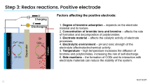
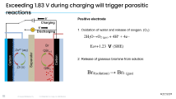
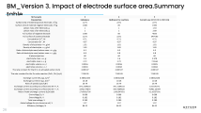
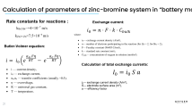
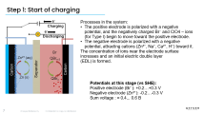
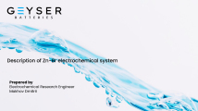
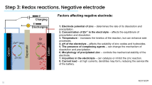
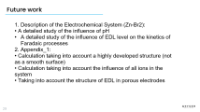
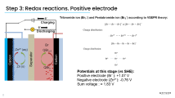
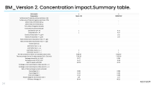
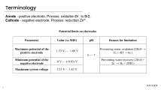
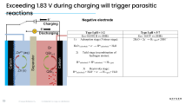
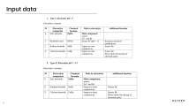
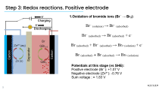
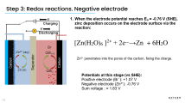
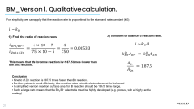
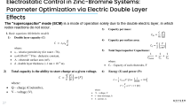
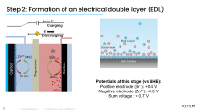
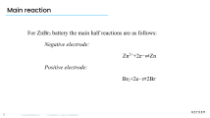
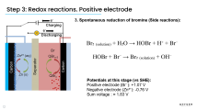
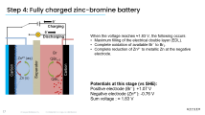
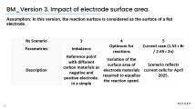
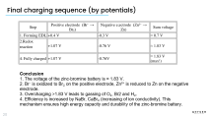
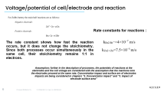
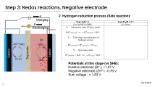
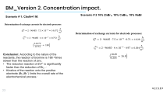
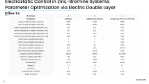
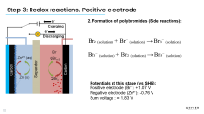
Contains

Slide 3
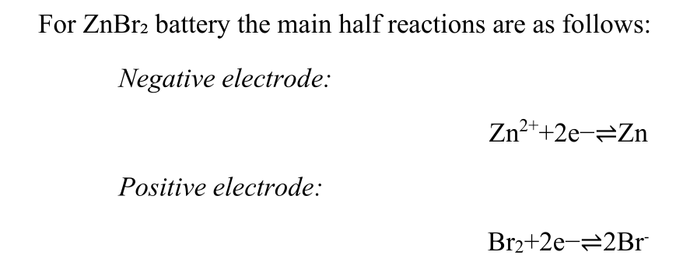
Main reaction

Slide 4
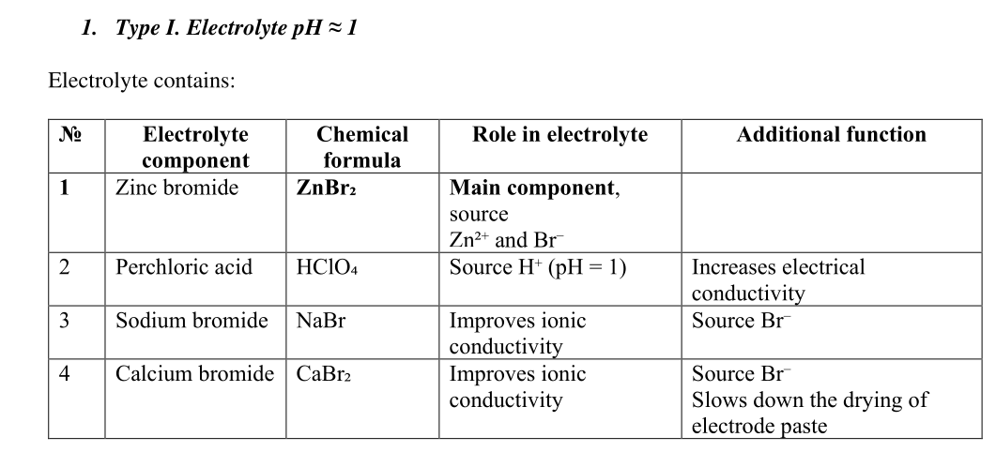
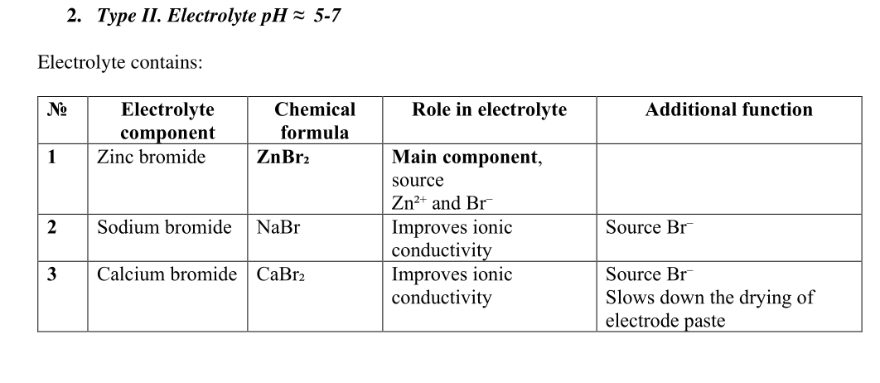
Input data

Slide 5
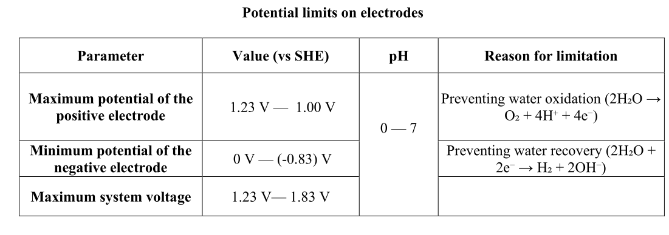
Terminology
Anode - positive electrode. Process: oxidation Br⁻ to Br2;
Cathode - negative electrode. Process: reduction Zn²⁺.

Slide 6

Voltage/potential of cell/electrode and reaction
Rate constants for reactions :
The rate constant shows how fast the reaction occurs, but it does not change the stoichiometry. Since both processes occur simultaneously in the same cell, their stoichiometry remains 1:1 in electrons.
Assumption: further in the description of processes, the potentials of reactions at the
electrodes and the cell voltage are considered with the assumption that the reactions onto
the electrodes proceed at the same rate. Concentration impact and surface are of electrodes
impacts are being considered in chapters “2. Concentration impact” and “3. Impact of
electrode surface area”

Slide 7
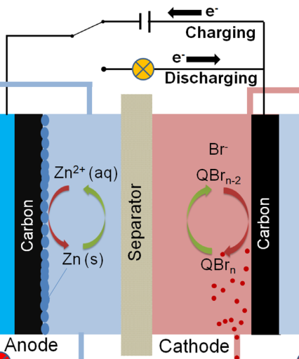
Step 1: Start of charging
Processes in the system:
The positive electrode is polarized with a negative potential, and the negatively charged Br⁻ and ClO4 – ions (for Type I) begin to move toward the positive electrode.
The negative electrode is polarized with a negative potential, attracting cations (Zn²⁺, Na⁺, Ca²⁺, H⁺) toward it.
The concentration of ions near the electrode surface increases and an initial electric double layer
(EDL) is formed.
Potentials at this stage (vs SHE):
Positive electrode (Br⁻): +0.2…+0.3 V
Negative electrode (Zn²⁺): -0.2…-0.3 V
Sum voltage : ≈ 0.4... 0.6 В

Slide 8
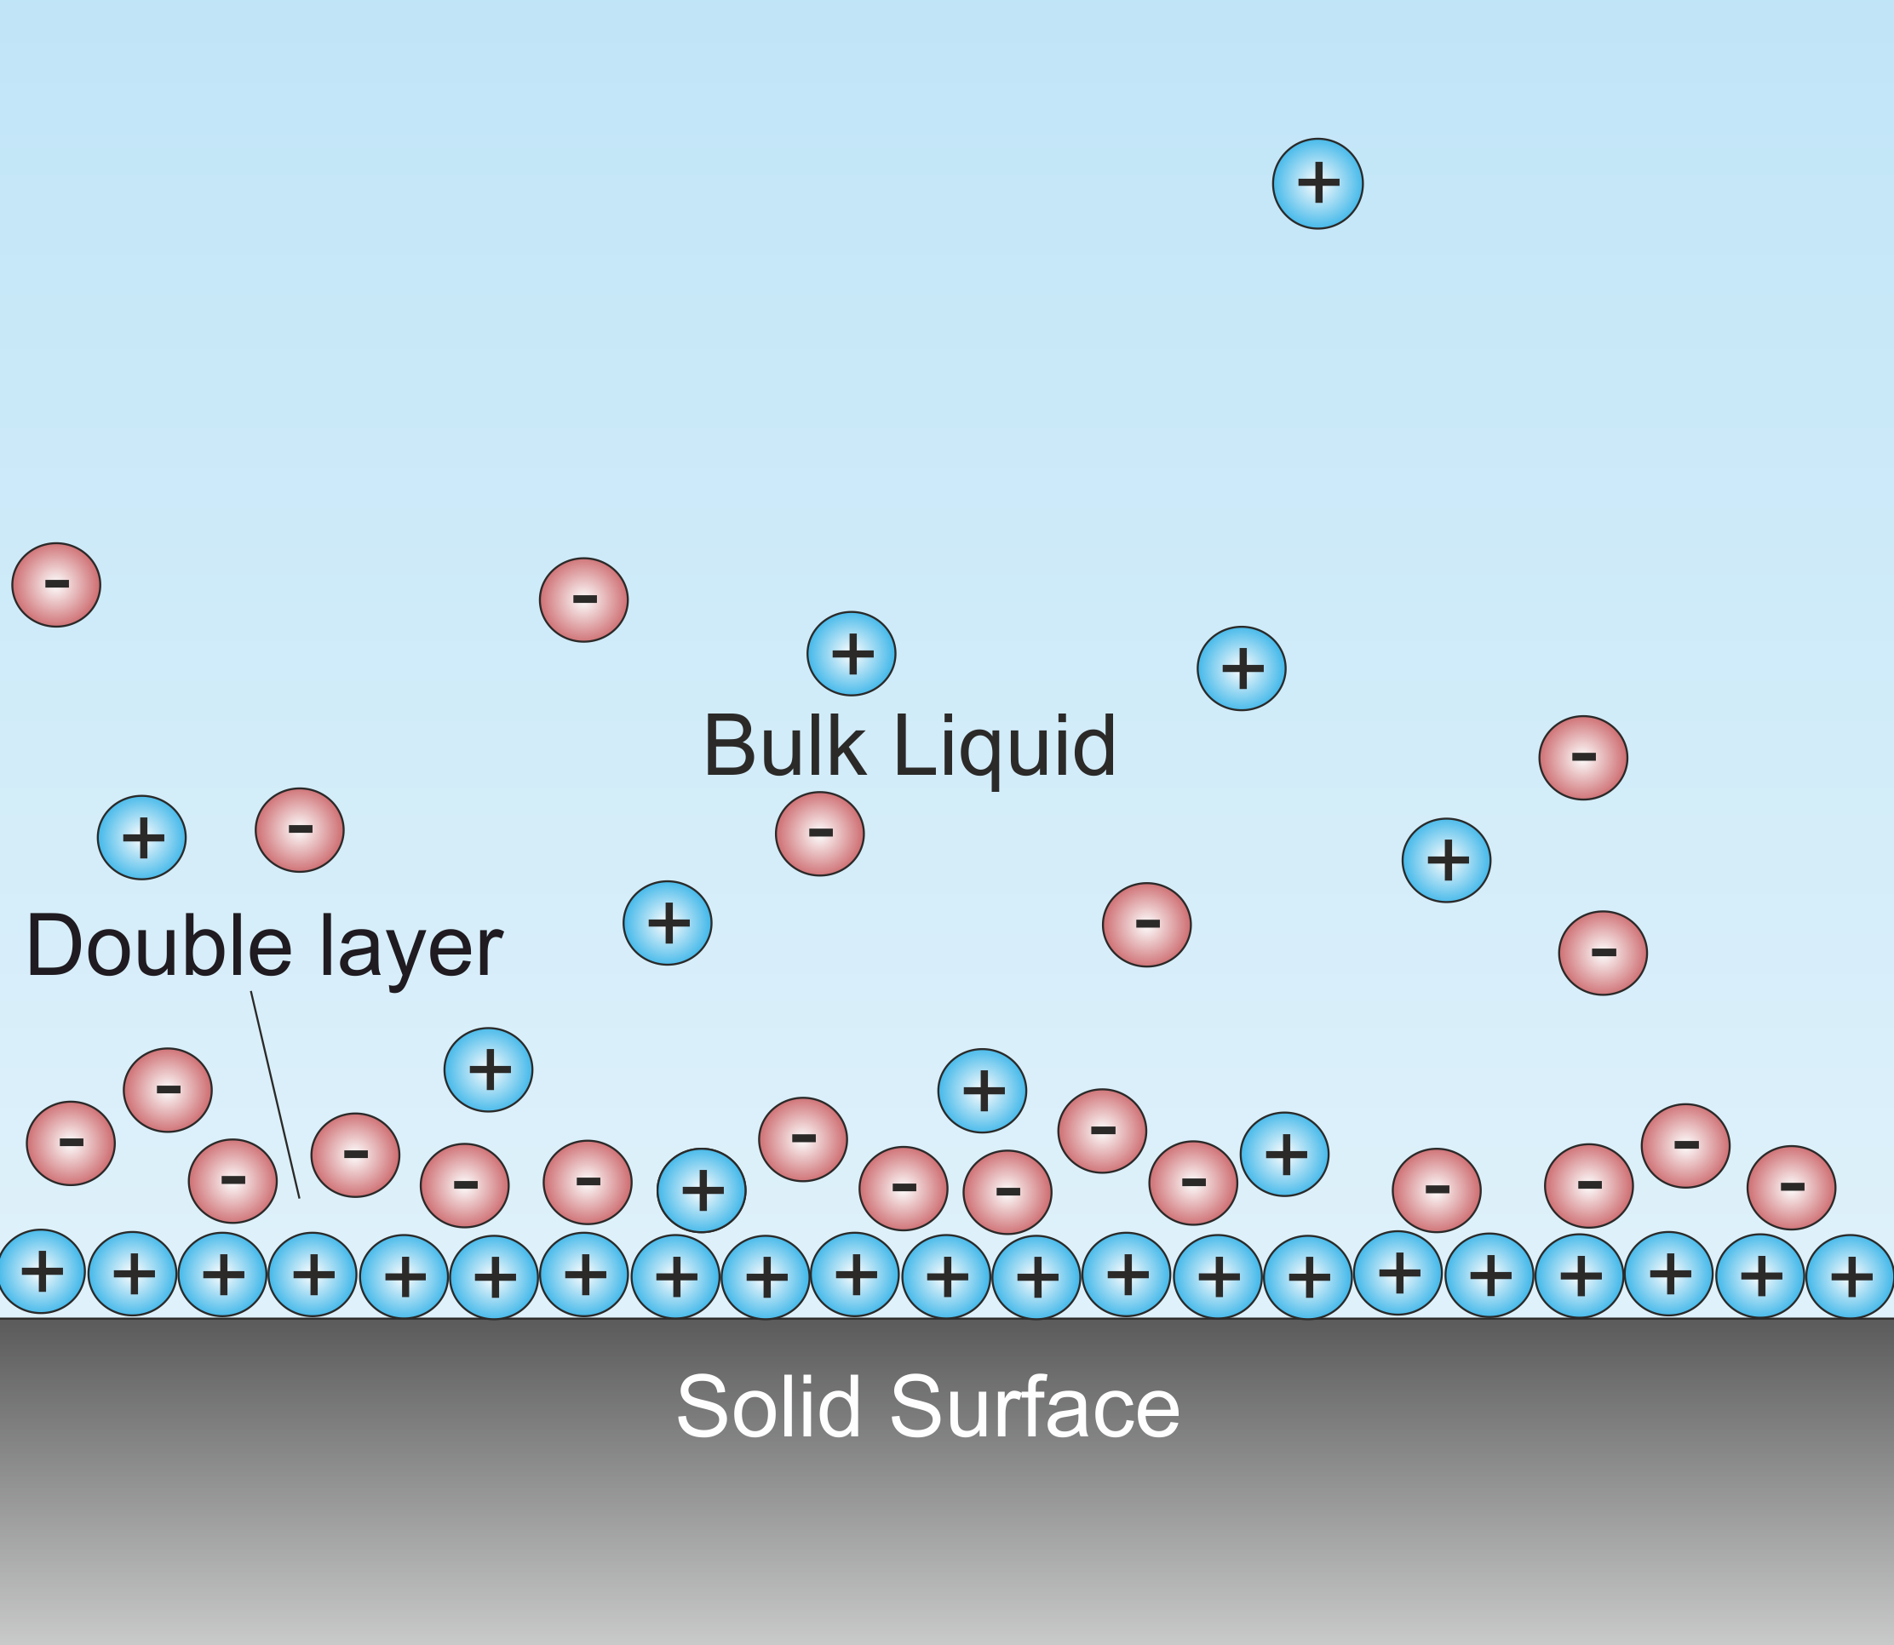
Step 2: Formation of an electrical double layer (EDL)
Potentials at this stage (vs SHE):
Positive electrode (Br⁻): +0.4 V
Negative electrode (Zn²⁺): -0.3 V
Sum voltage : ≈ 0.7 V

Slide 9
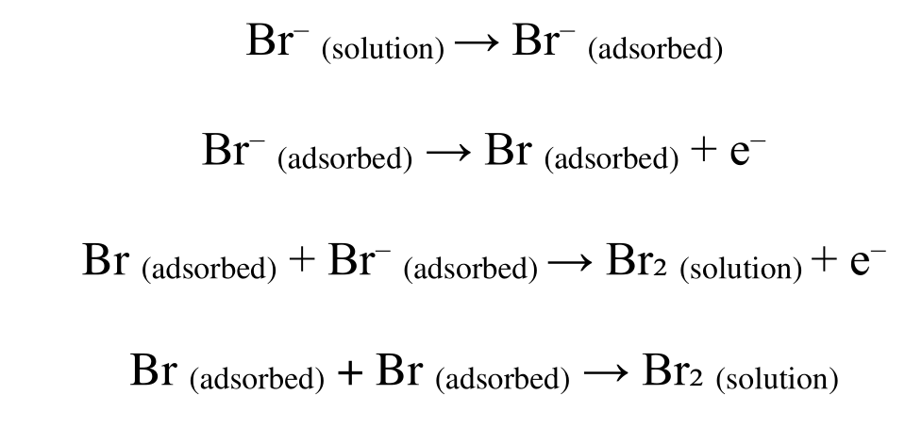
Step 3: Redox reactions. Positive electrode
1.Oxidation of bromide ions (Br⁻ → Br₂):
Potentials at this stage (vs SHE):
Positive electrode (Br⁻): +1.07 V
Negative electrode (Zn²⁺): -0.76 V
Sum voltage : ≈ 1.83 V

Slide 10
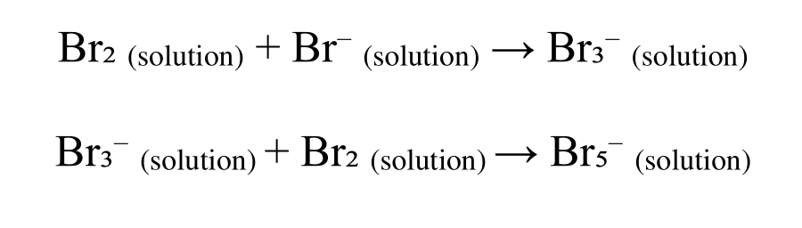
Step 3: Redox reactions. Positive electrode
2. Formation of polybromides (Side reactions):
Potentials at this stage (vs SHE):
Positive electrode (Br⁻): +1.07 V
Negative electrode (Zn²⁺): -0.76 V
Sum voltage : ≈ 1.83 V

Slide 11
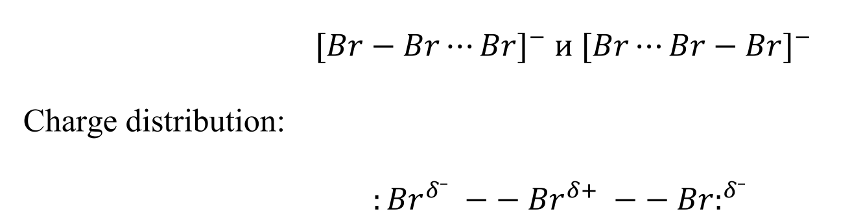
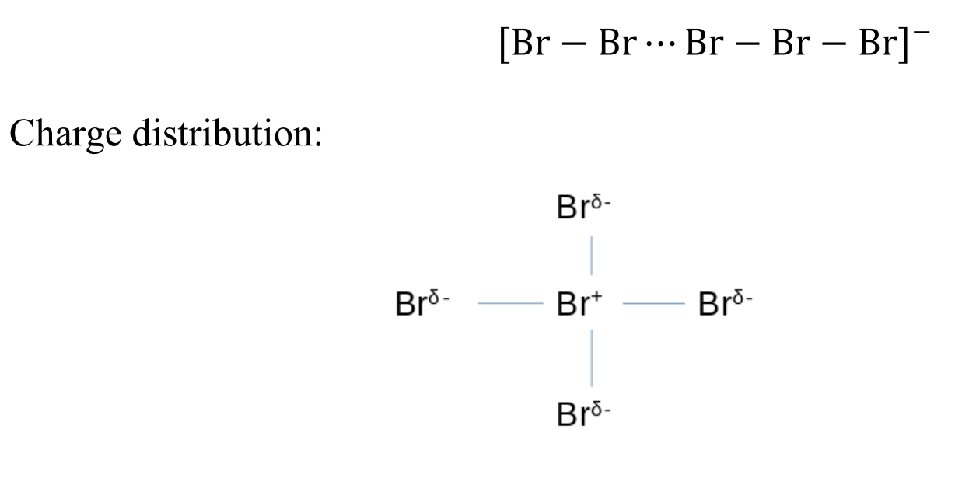
Step 3: Redox reactions. Positive electrode
Tribromide ion (Br₃⁻) and Pentabromide ion (Br₅⁻) according to VSEPR theory:
Potentials at this stage (vs SHE):
Positive electrode (Br⁻): +1.07 V
Negative electrode (Zn²⁺): -0.76 V
Sum voltage : ≈ 1.83 V

Slide 12
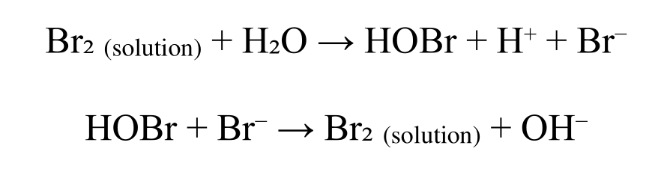
Step 3: Redox reactions. Positive electrode
3. Spontaneous reduction of bromine (Side reactions):
Potentials at this stage (vs SHE):
Positive electrode (Br⁻): +1.07 V
Negative electrode (Zn²⁺): -0.76 V
Sum voltage : ≈ 1.83 V

Slide 13
Step 3: Redox reactions. Positive electrode
Factors affecting the positive electrode:
1. Degree of bromine adsorption – depends on the electrode material and its texture.
2. Concentration of bromide ions and bromine – affects the rate of formation and decomposition of polybromides.
3. Electrode material – affects the catalytic activity of electrode processes.
4. Electrolytic environment – pH and ionic strength of the electrolyte affectnelectrochemical activity.
5. Temperature – high temperature increases the diffusion of bromine and polybromides, increasing the risk of self-discharge.
6. Side reactions – the formation of COBr and its interaction with electrolyte materials can reduce the stability of the system.

Slide 14
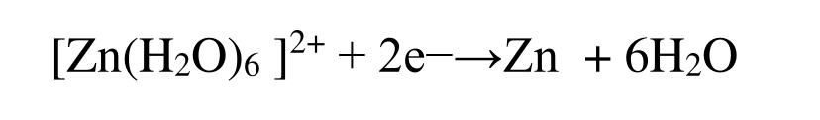
Step 3: Redox reactions. Negative electrode
When the electrode potential reaches E₀ = -0.76 V (SHE), zinc deposition occurs on the electrode surface via the reaction:
Zn²⁺ penetrates into the pores of the carbon, fixing the charge.
Potentials at this stage (vs SHE):
Positive electrode (Br⁻): +1.07 V
Negative electrode (Zn²⁺): -0.76 V
Sum voltage : ≈ 1.83 V

Slide 15
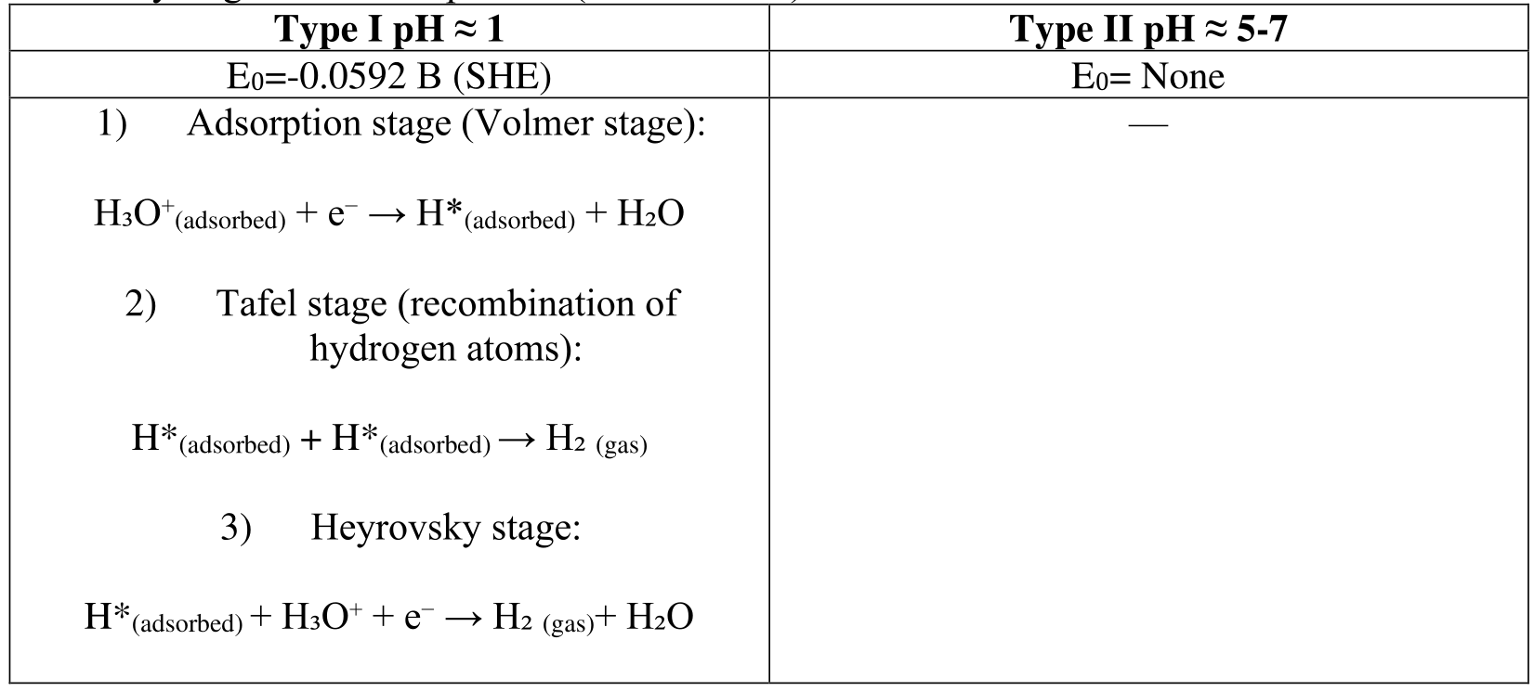
Step 3: Redox reactions. Negative electrode
2. Hydrogen reduction process (Side reaction):
Potentials at this stage (vs SHE):
Positive electrode (Br⁻): +1.07 V
Negative electrode (Zn²⁺): -0.76 V
Sum voltage : ≈ 1.83 V

Slide 16
Step 3: Redox reactions. Negative electrode
Factors affecting negative electrode:
1. Electrode potential of zinc – determines the rate of its dissolution and precipitation.
2. Concentration of Zn²⁺ in the electrolyte – affects the equilibrium of precipitation and dissolution.
3. Temperature – increases the kinetics of the reaction, but can enhance side processes.
4. pH of the electrolyte – affects the solubility of zinc oxides and hydroxides.
5. The presence of complexing agents – can change the mechanism of dissolution and precipitation.
6. Morphology of precipitated zinc – controls the mechanical stability of the electrode.
7. Impurities in the electrolyte – can catalyze or inhibit the zinc reaction.
8. Current load – at high currents, dendrites may form, reducing the service life of the battery.

Slide 17
Step 4: Fully charged zinc-bromine battery
When the voltage reaches ≈1.83 V, the following occurs:
Maximum filling of the electrical double layer (EDL).
Complete oxidation of available Br⁻ to Br₂.
Complete reduction of Zn²⁺ to metallic Zn at the negative electrode.
Potentials at this stage (vs SHE):
Positive electrode (Br⁻): +1.07 V
Negative electrode (Zn²⁺): -0.76 V
Sum voltage : ≈ 1.83 V

Slide 18
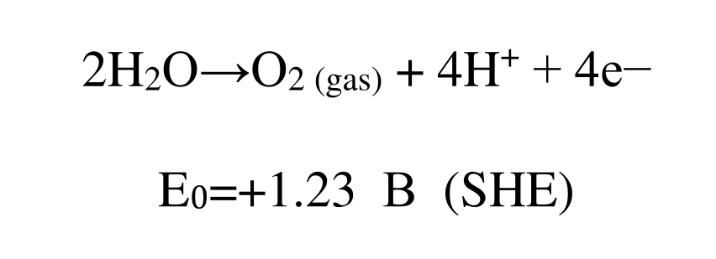

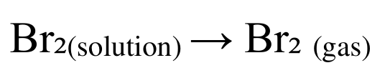
Exceeding 1.83 V during charging will trigger parasitic reactions
Positive electrode
1. Oxidation of water and release of oxygen. (O₂):
2. Release of gaseous bromine from solution:

Slide 19
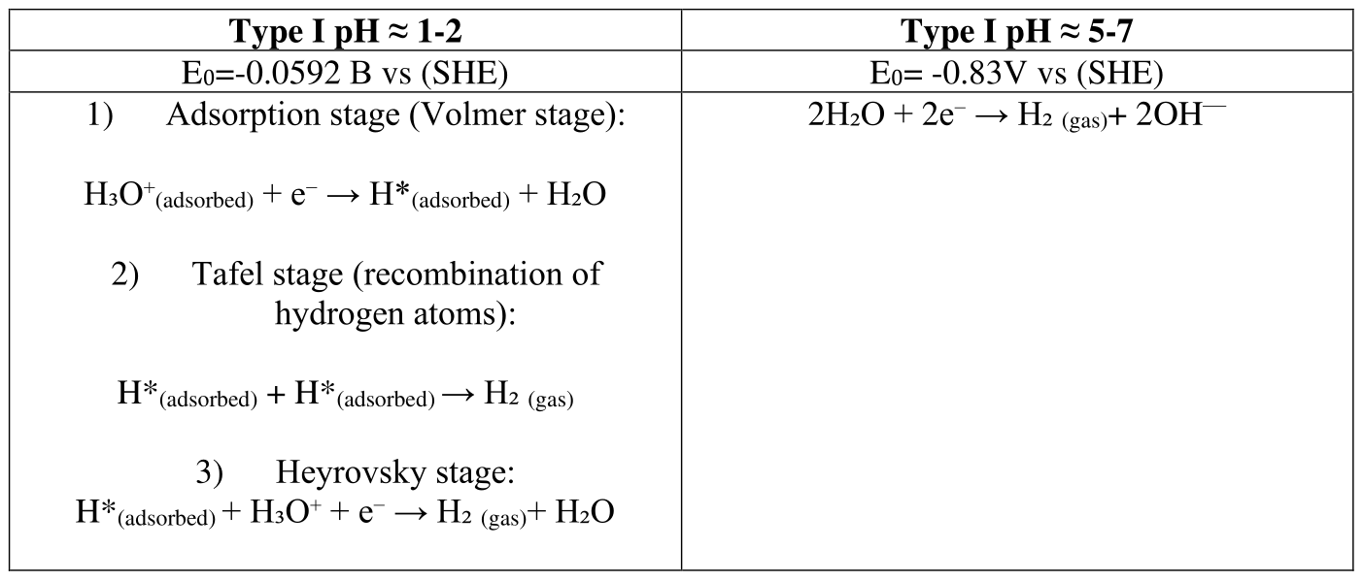
Exceeding 1.83 V during charging will trigger parasitic reactions
Negative electrode

Slide 20
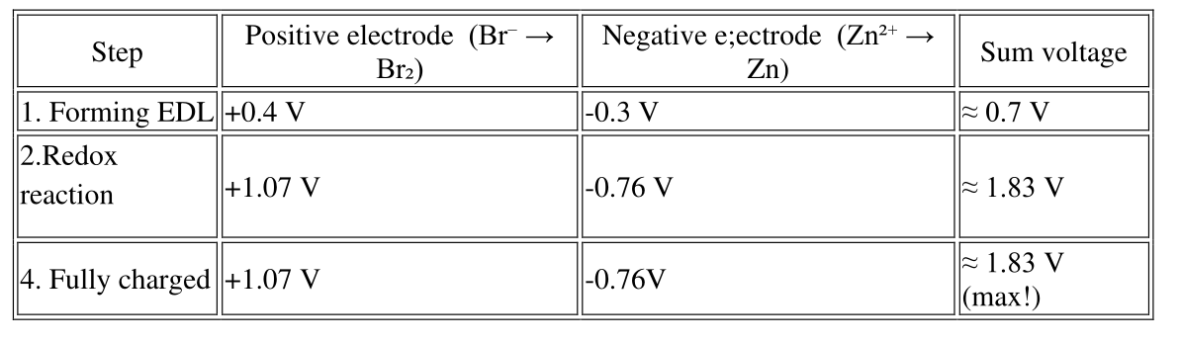
Final charging sequence (by potentials)
Conclusion
1. The voltage of the zinc-bromine battery is ≈ 1.83 V.
2. Br⁻ is oxidized to Br₂ on the positive electrode, Zn²⁺ is reduced to Zn on the negative electrode.
3. Overcharging >1.83 V leads to gassing of O₂, Br2 and H₂.
4. Efficiency is increased by NaBr, CaBr₂ (increasing of ion conductivity). This mechanism ensures high energy capacity and durability of the zinc-bromine battery.

Slide 21
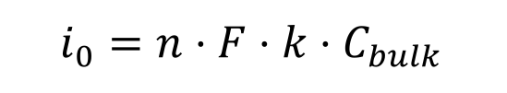
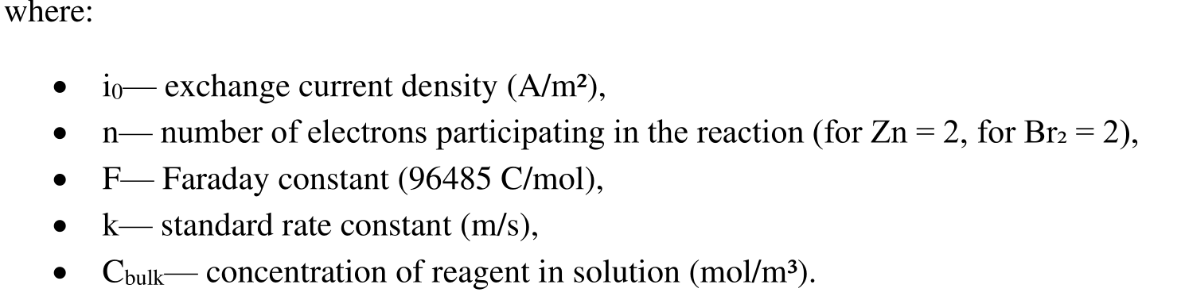
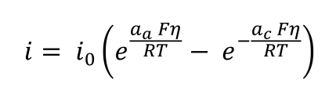
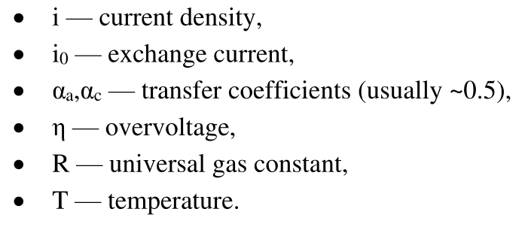

Calculation of parameters of zinc-bromine system in “battery mode”
Rate constants for reactions :
Exchange current:
Butler-Volmer equation:
Calculation of total exchange currents:
i₀— exchange current density (A/m²),
S— electrode surface area (m²),
a — efficiency factor

Slide 22

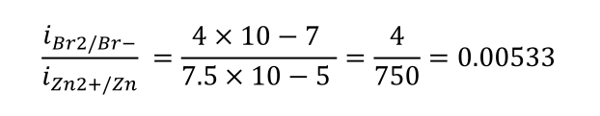


BM_Version 1. Qualitative calculation.
For simplicity, we can apply that the reaction rate is proportional to the standard rate constant (k0):
Find the ratio of reaction rates
2) Condition of balance of reaction rates.
This means that the bromine reaction is ~187.5 times slower than the zinc reaction.
Conclusion
• Kinetic of Zn reaction is 187.5 times faster then Br reaction.
• For the system to work efficiently, the reaction rates at both electrodes must be balanced.
• In simplified version reaction surface area for Br reaction should be 185.5 times large.
• Such a large ratio means that the Br₂/Br⁻ electrode must be highly developed (e.g. porous, with a highly active coating)

Slide 23


BM_Version 2. Concentration impact.
Scenario # 1. Cbulk=1 M.
Scenario # 2 16% ZnBr₂, 18% CaBr₂, 18% NaBr
Conclusion: According to the nature of the reactants, the reaction of bromine is 188 =times slower than the reaction of zinc.
The reduction reaction of Zn²⁺ is significantly faster than the reduction of Br₂ .·
Kinetics of the reaction onto the positive electrode (Br₂/Br⁻) limits the overall rate of the electrochemical process.·

Slide 24
BM_Version 2. Concentration impact.Summary table.
№ Scenario | 1 | 2
Parametries | Cbulk​=1 M | 18B18C16Z
Surface area of ​​material positive electrode, m²/g | - | -
Surface area of ​​material negative electrode, m²/g | - | -
carbon mass of Br-electrode, g | - | -
carbon mass of Zn-electrode, g | - | -
Full surface of negative electode
Full surface of positive electode
Concetration Zn²⁺, M | 1 | 0.71
Concetration Br⁻, M | 1 | 4.97
Density of electrolyte «+», g/ml |  | 1.62
Density of electrolyte «-», g/ml |  | 1.65
Ratio of electrolyte mass/carbon mass «+», g/g
Ratio of electrolyte mass/carbon mass «-», g/g
% electrolyte loss
electrolyte mass «+», g
electrolyte mass «-», g
electrolyte volume «+», l | 1 | 1
electrolyte volume «-», l | 1 | 1
The rate constant for the Br 2 on activated carbon (m/s) | 4.00E-07 | 4.00E-07
The rate constant for the Zn redox reaction (Zn2+ /Zn) (m/s) | 7.50E-05 | 7.50E-05
Exchange current Br₂ (j₀), A/m² | 0.077 | 0.384
Exchange current Zn (j₀), A/m² | 14.47 | 10.28
Ratio of speeds (i₀Zn/i₀Br) | 187.50 | 26.79
Exchange current according to surface area I0«+», A
Exchange current according to surface area I0 «-», A
Ratio of total exchange currents (I₀Zn/I₀Br)
Overvoltage Zn, V | 0.089 | 0.098
Overvoltage Br, V | 0.223 | 0.182
Total overvoltage, V | 0.312 | 0.280
Actual voltage for zinc-bromine cell, V | 1.54 | 1.57
Efficiency (Voltage), % | 84.44 | 86.22

Slide 25
BM_Version 3. Impact of electrode surface area.
Assumption: In this version, the reaction surface is considered as the surface of a flat electrode.
№ Scenario | 3 | 4 | 5
Parametries | Imbalance | Optimum for reactions | Current case (1.53 г Br / 2.69 г Zn)
Description | Reference point with different carbon materials as negative and positive electrode. In a simple | Variation of the surface area of electrode materials required to equalize the reaction speed. | Scenario reflects current cells for April 2025.

Slide 26
BM_Version 3. Impact of electrode surface area.Summary table.
№ Scenario | 3 | 4 | 5
Parametries | Imbalance | Optimum for reactions | Current case (1.53 г Br / 2.69 г Zn)
Surface area of ​​material positive electrode, m²/g | 2271 | 2271 | 2271
Surface area of ​​material negative electrode, m²/g | 1500 | 85 | 1500
carbon mass of Br-electrode, g | 1 | 1 | 1.53
carbon mass of Zn-electrode, g | 1 | 1 | 2.69
Full surface of negative electode | 1500 | 85 | 4035
Full surface of positive electode | 2271 | 2271 | 3474.63
Concetration Zn²⁺, M | 0.71 | 0.71 | 0.71
Concetration Br⁻, M | 4.97 | 4.97 | 4.97
Density of electrolyte «+», g/ml | 1.62 | 1.62 | 1.62
Density of electrolyte «-», g/ml | 1.65 | 1.65 | 1.65
Ratio of electrolyte mass/carbon mass «+», g/g | 6.5 | 6.5 | 6.5
Ratio of electrolyte mass/carbon mass «-», g/g | 6.8 | 6.8 | 6.8
% electrolyte loss | 60 | 60 | 60
electrolyte mass «+», g | 2.6 | 2.6 | 3.978
electrolyte mass «-», g | 2.72 | 2.72 | 7.3168
electrolyte volume «+», l | 0.0016 | 0.0016 | 0.0025
electrolyte volume «-», l | 0.0016 | 0.0016 | 0.0044
The rate constant for the Br 2 on activated carbon (m/s) | 4.00E-07 | 4.00E-07 | 4.00E-07
The rate constant for the Zn redox reaction (Zn2+ /Zn) (m/s) | 7.50E-05 | 7.50E-05 | 7.50E-05
Exchange current Br₂ (j₀), A/m² | 0.38362436 | 0.38362436 | 0.38362436
Exchange current Zn (j₀), A/m² | 10.28 | 10.28 | 10.28
Ratio of speeds (i₀Zn/i₀Br) | 26.79 | 26.79 | 26.79
Exchange current according to surface area I0«+», A | 871.2109216 | 871.2109216 | 1332.95271
Exchange current according to surface area I0 «-», A | 15413.47875 | 873.4304625 | 41462.25784
Ratio of total exchange currents (I₀Zn/I₀Br) | 17.69201736 | 1.002547651 | 31.10557301
Overvoltage Zn, V | 0.098 | 0.098 | 0.098
Overvoltage Br, V | 0.182 | 0.182 | 0.182
Total overvoltage, V | 0.280 | 0.280 | 0.280
Actual voltage for zinc-bromine cell, V | 1.57 | 1.57 | 1.57
Efficiency (Voltage), % | 86.22 | 86.22 | 86.22

Slide 27





Electrostatic Control in Zinc-Bromine Systems:
Parameter Optimization via Electric Double Layer
Effects
The "supercapacitor" mode (SCM) is a mode of operation solely due to the double electric layer, in which redox reactions do not occur.

Slide 28
Electrostatic Control in Zinc-Bromine Systems:
Parameter Optimization via Electric Double Layer
Effects
№ Scenario | 3 | 4 | 5
Parametries | Imbalance | Optimum for reactions | Current case (1.53 г Br / 2.69 г Zn)
Name of material positive electrode | YP80F | YP80F | YP80F
Name of material negative electrode | PBX51 | PBX52 | PBX53
Surface Capacitance of positive electrode, F/m2 | 0.15 | 0.15 | 0.15
Surface Capacitance of negative electrode, F/m2 | 0.12 | 0.12 | 0.12
Surface area of ​​material positive electrode, m²/g | 2271 | 2271 | 2271
Surface area of ​​material negative electrode, m²/g | 1500 | 85 | 1500
carbon mass of positive electrode, g | 1 | 1 | 1.53
carbon mass of negative electrode, g | 1 | 1 | 2.69
Full surface of negative electode, m² | 1500 | 85 | 4035
Full surface of positive electode, m² | 2271 | 2271 | 3474.63
Ratio of full surface positive/negative | 1.514 | 26.718 | 0.861
Capacity of positive electrode, F | 340.65 | 340.65 | 521.1945
Capacity of negative electrode, F | 180 | 10.2 | 484.2
Electrode capacity ratio C₊/C₋ | 1.89 | 33.40 | 1.08
Total capacity, F | 117.77 | 9.90 | 251.01
Voltage, V | 1.7 | 1.7 | 1.7
Current, A | 8 | 8 | 8
Energy Stored in cell, Wh | 0.047 | 0.004 | 0.101
Power for cell, W | 13.6 | 13.6 | 13.6

Slide 29
Future work
1. Description of the Electrochemical System (Zn-Br2):
• A detailed study of the influence of pH
A detailed study of the influence of EDL level on the kinetics of Faradaic processes
2. Appendix_1:
• Calculation taking into account a highly developed structure (not as a smooth surface)
• Calculation taking into account the influence of all ions in the system
• Taking into account the structure of EDL in porous electrodes

